Slide 1
Mantid Current Development and other news
Nicholas Draper
Scientific Steering Committee 2015

Slide 2
Agenda

Slide 3
Releases
Complete releases since last SSC
v3.1 7th Feb 2014
v3.1.1 28th Feb 2014
v3.2 14th July 2014
V3.2.1 28th August 2014
v3.3 19th January 2015

Slide 4
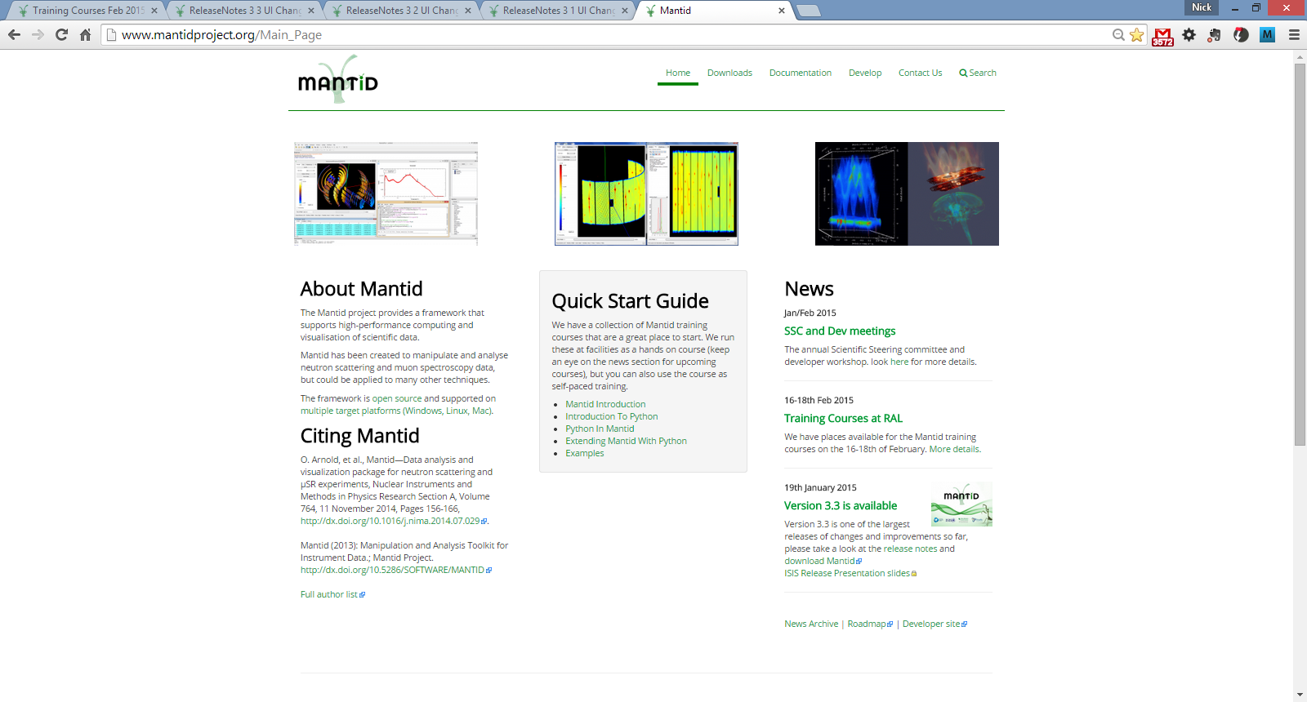
Roadmap

Slide 5
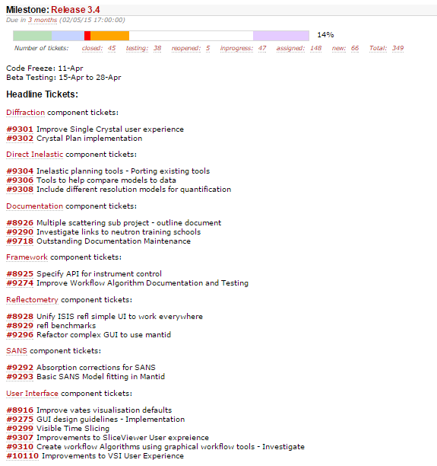
Roadmap

Slide 6
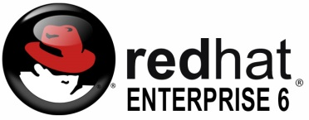






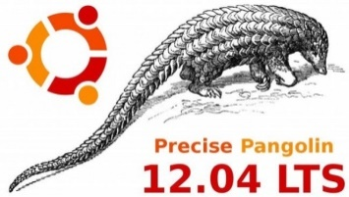
Supported Platforms
Staying the same
RHEL 6 64bit
OSX Mountain Lion +
Windows 7 64 bit
Ubuntu 14.04 64 bit
Limited support for
Windows 8 64 bit
Fedora 20
RHEL 7 64bit
No Longer supported
Ubuntu 12.04 64 bit

Slide 7





Contributors
NMI3 supported evaluation
IN4,5 & 6
D33
Focus
Lujan Nexus Load algorithm
Improving McStas – Mantid integration
LoadMcStas
TofTof

Slide 8
Other groups interested in Mantid
Partners
ESS
C-SNS
ILL?
J-PARC?
Collaborators
PSI
ANSTO – Bilby
HMI - EXED

Slide 9
Progress on SSC requirements
mostly framework

Slide 10
6 Month view
Items currently under development
Tiling displays
Multi data fitting
CLI (for VATES)
Planned development starting <6m
Workflow Algorithms
History depth / extracting scripts
Masking redesign(LT)
Improve GUIs
Improve Vates defaults
Documentation maintenance (ongoing)
Load performance
Plotting improvements
Repo. for instrument files
Spec API for instr. control

Slide 11
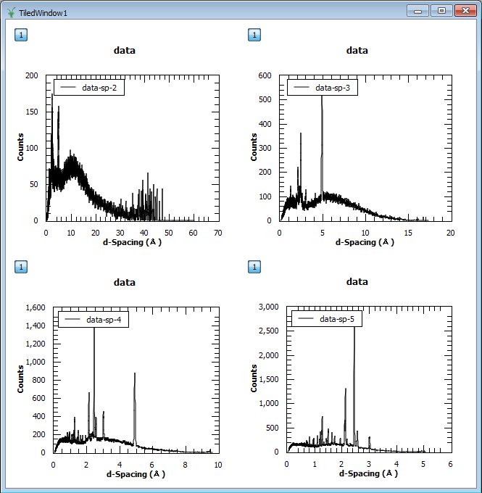
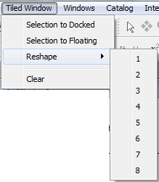
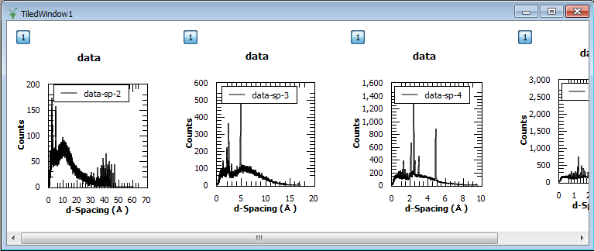
Tiled graphs
Add graphs by drag and drop
Rearrange
Select and remove
Reshape

Slide 12
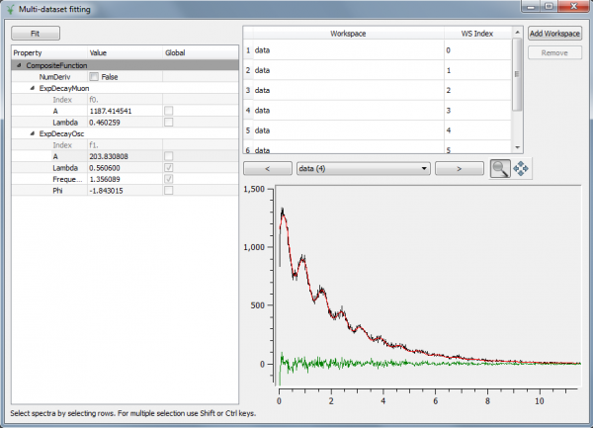
Multi-Dataset Fitting
New interface for fitting across multiple data sets
Possible before but only from scripts
Missing some features of main fitting but is fully usable

Slide 13
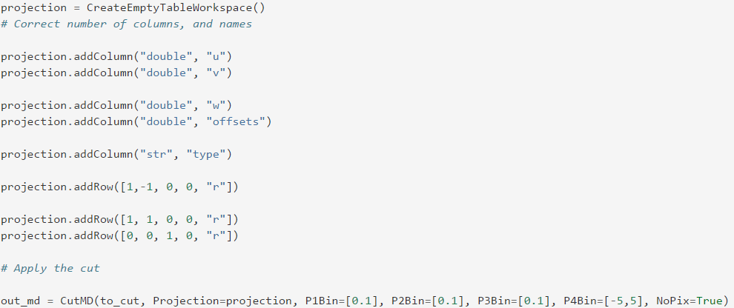
CLI (for VATES)
Cutting Syntax
Similar to Horace
Uses a projection table to define the slice
Extents calculated in new basis if not provided
Currently works for 3D and 3D data, needs extending to other cases
http://docs.mantidproject.org/nightly/algorithms/CutMD-v1.html

Slide 14
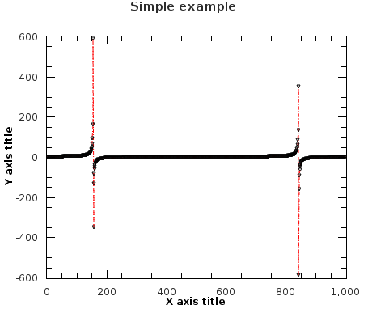
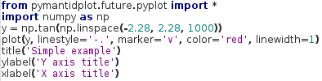
Python Command Line Interface
Experimental: from pymantidplot.future.pyplot import *
/ import pymantidplot.future.pyplot as plt
Harmonized interface:
plot(source=[{Workspace(s)}], tool={ToolName}, **kwargs)
ToolName: ‘plot_spectrum’, ‘plot_bin’, ‘plot_md’, …
Functional interface (pyplot / matlab):

Slide 15
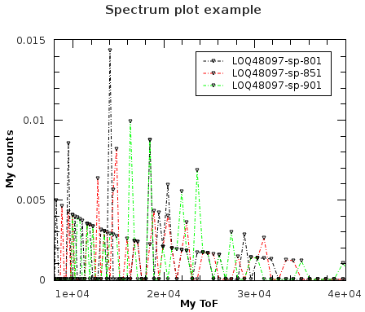
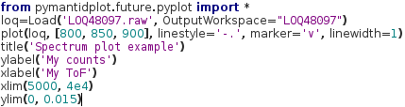
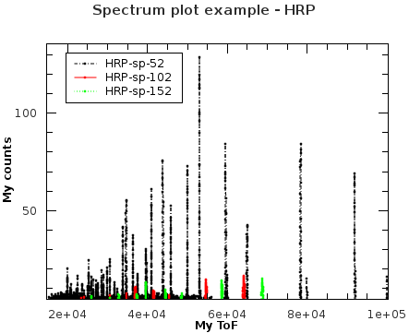
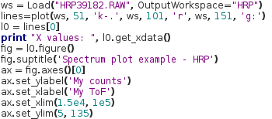
Python Command Line Interface
Plotting spectra:
Object-oriented interface (Figure, Axis, Line2D, etc.):

Slide 16
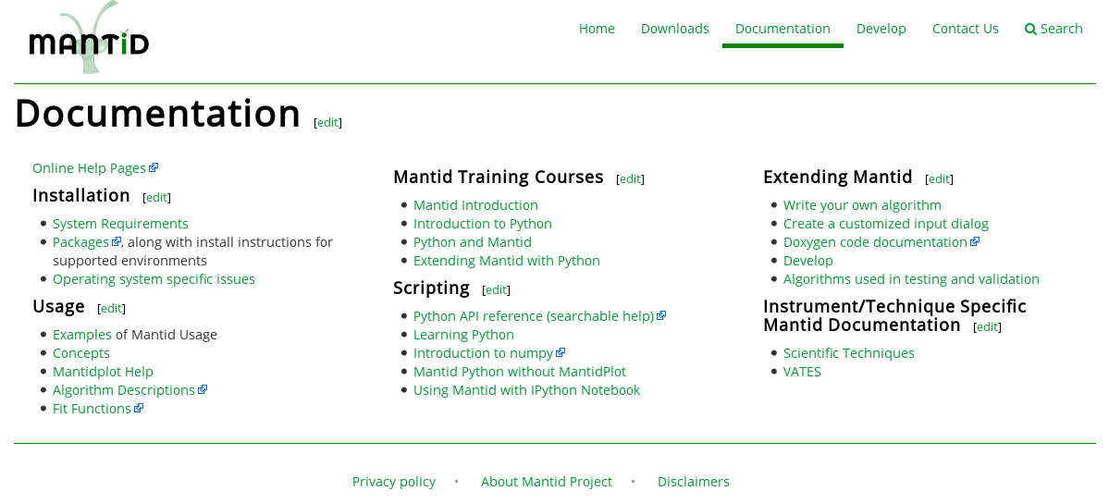
Python Command Line Interface
To learn how to use it:
help(pymantidplot.future.pyplot)
http://docs.mantidproject.org/nightly/api/python/index.html
Familiar interface, >90% like the Pyplot tutorial: http://matplotlib.org/users/pyplot_tutorial.html

Slide 17
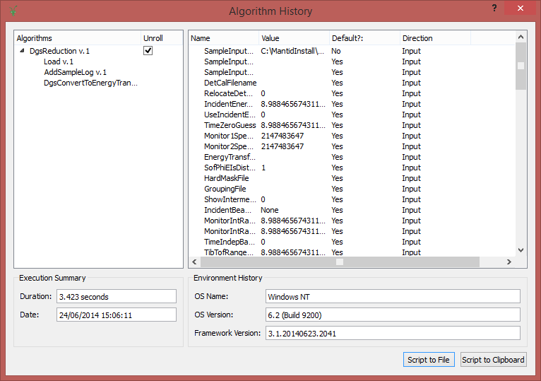
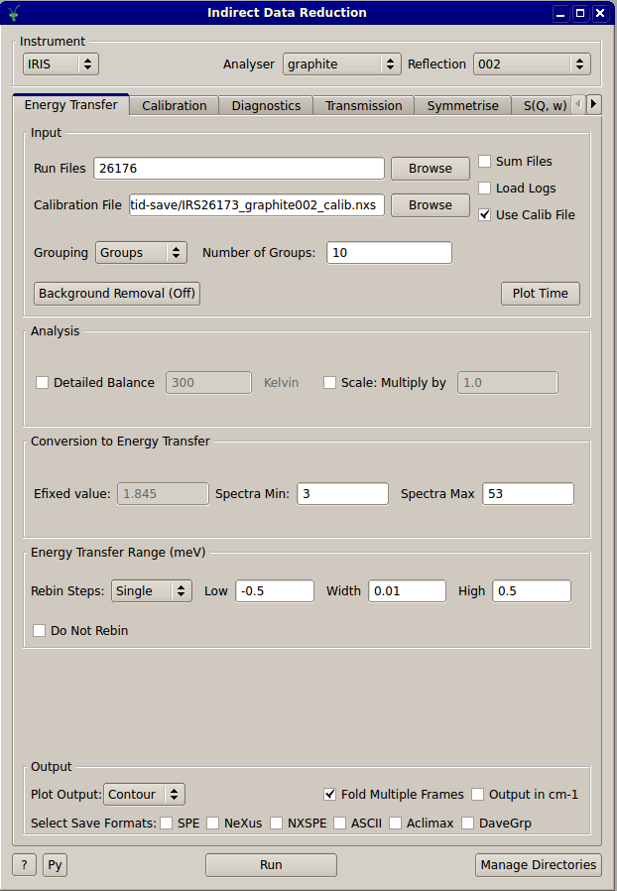
Workflow Algorithms History depth / extracting scripts
Workflow Diagrams
Nested History
Able to reveal the underlying step of Workflow Algorithms
No more black boxes
User interfaces
Output script buttons
Not universal yet

Slide 18
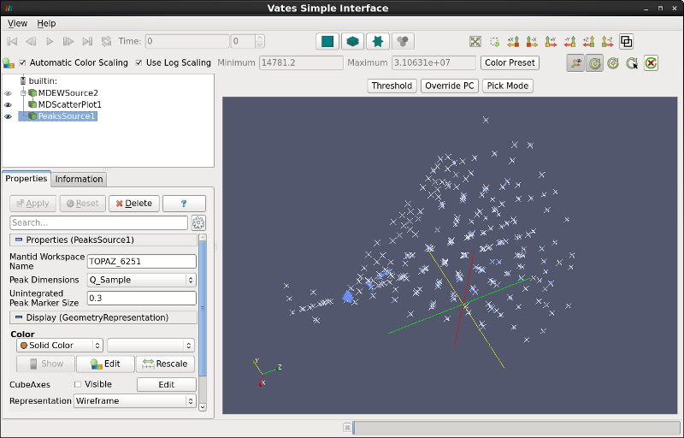
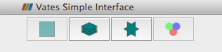
Improve Vates defaults
Technique dependent initial view in VSI
Not quite ready for release 3.3
More powerful in-situ rebinning
Better colour map boundaries and harmonization
Better default rebinning
Faster representations at lower memory overhead
Faster slicing
Multi-window mode
A less confusing interface
http://www.mantidproject.org/VatesSimpleInterface_v2

Slide 19
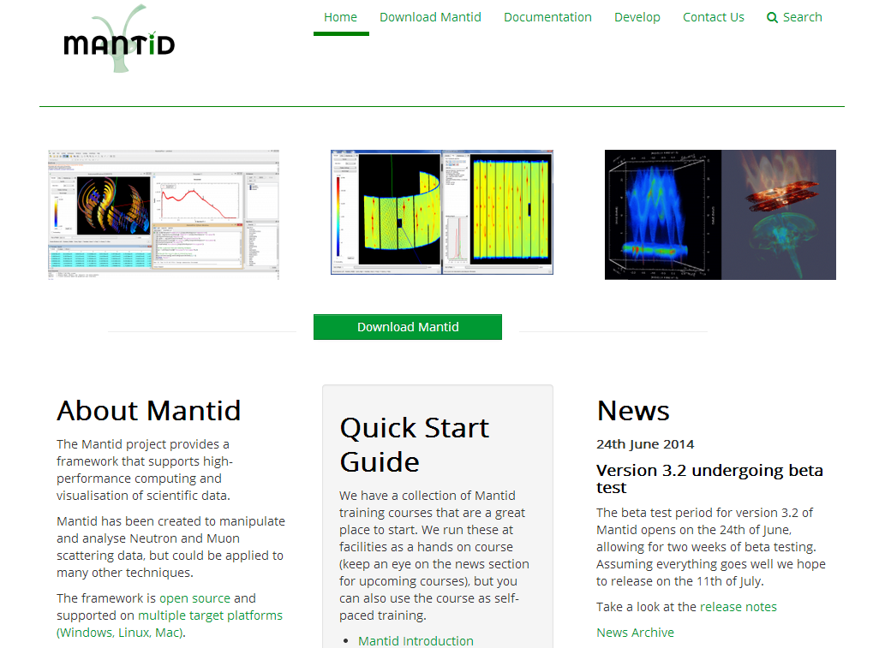
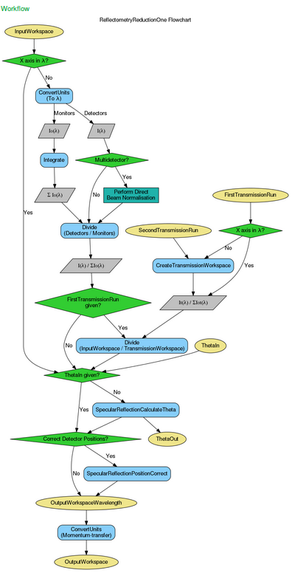
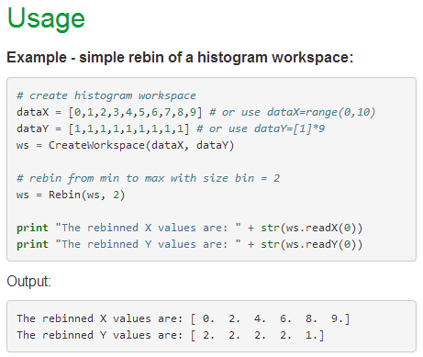
Documentation and Website
Look and feel
Redesigned Website
Stability
Moved to a cloud server
Functionality
Anyone can request accounts
Lots of outdated information removed
Algorithm & concepts
Many rewritten
Tested usage examples
Workflow Diagrams
Same information online and offline

Slide 20
Load Performance
Investigated HDF5 vs Nexus
Some gain to be had (around 20% in some cases)
Significant effort to change
Speedup for Workspace Groups
For 500 workspaces: 138 s => 8 s
Long History affecting load/save speed
Performance improved
Or use RemoveWorkspaceHistory
Memory Management
Very slow deletion of large histogram workspaces on Windows.
MERLIN reduction on Windows 11mins->2mins!

Slide 21
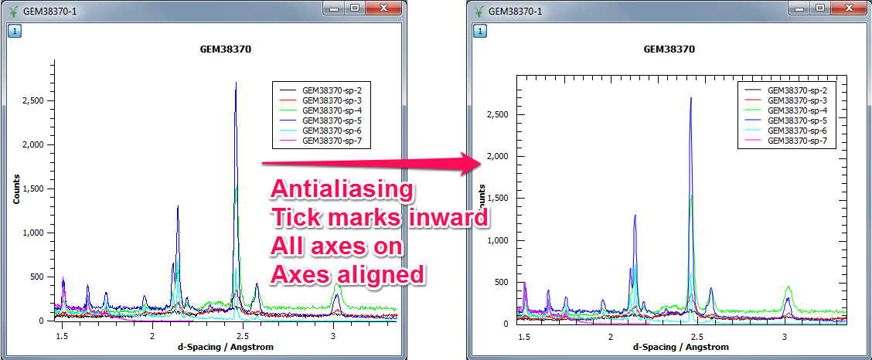
Plotting Improvements

Slide 22
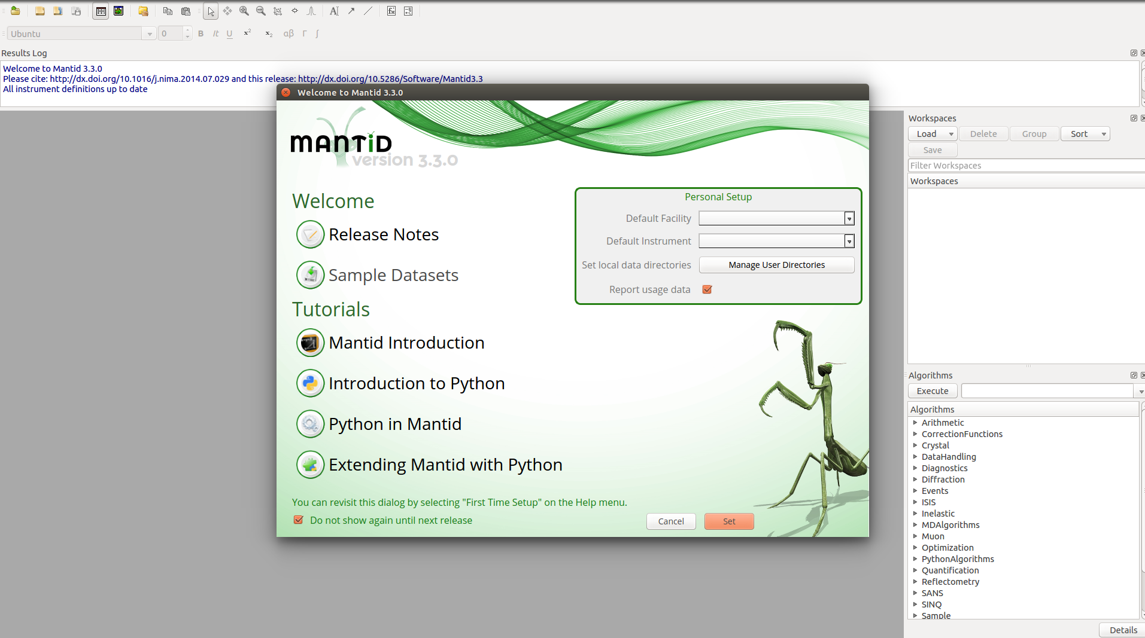

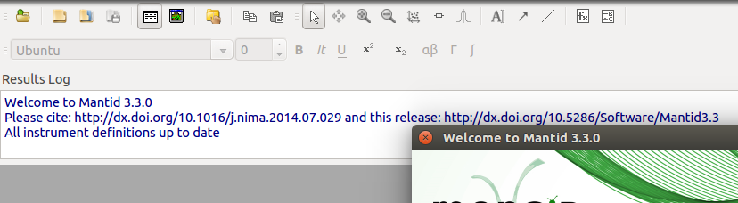
Instrument Definition Repository

Slide 23
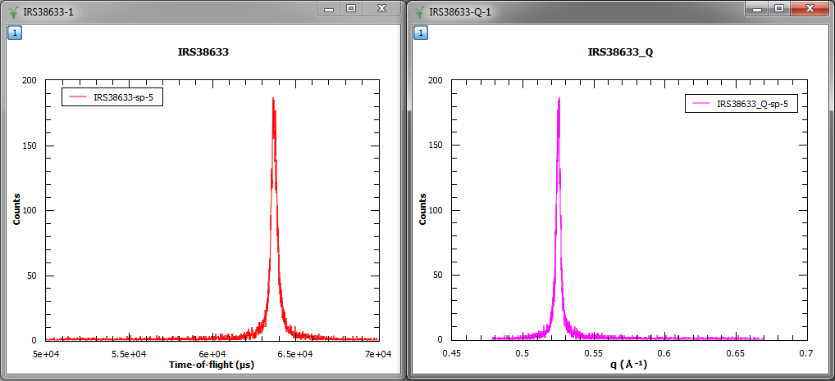
User Interface - Plotting
Auto-generated labels can use more standard labels, e.g. Greek symbols, sub/superscripts

Slide 24
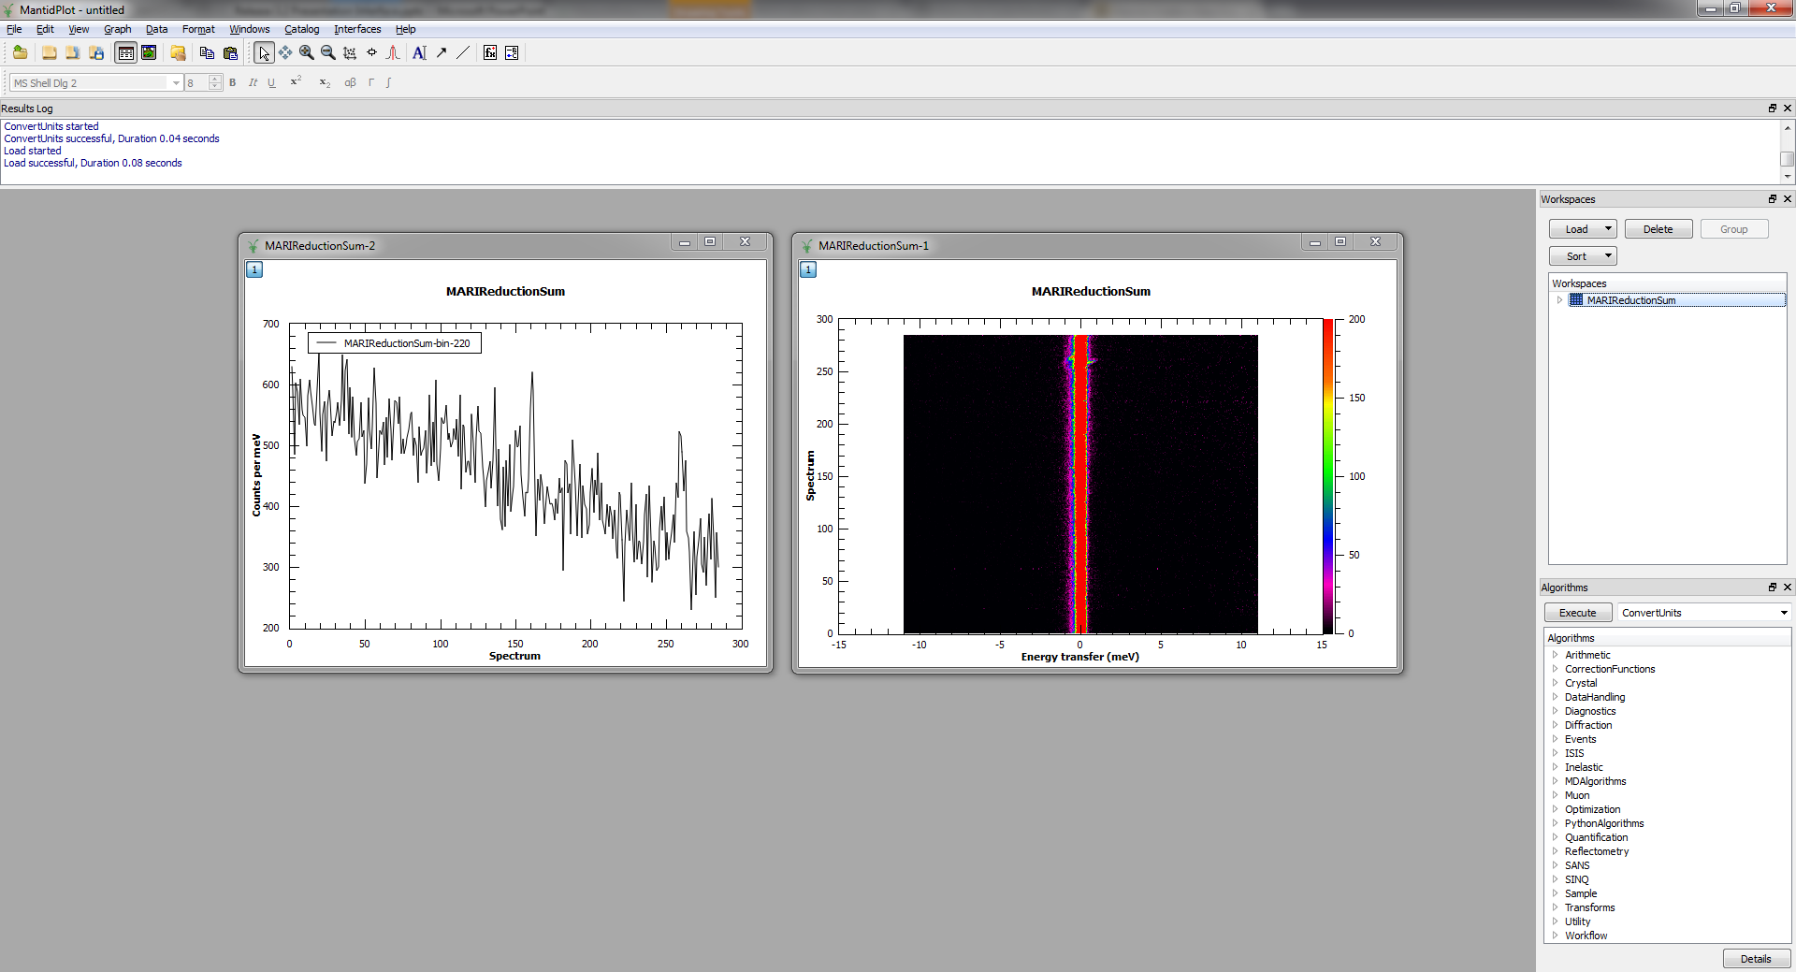
User Interface - Plotting
Bin/colour-fill plots not longer require a table

Slide 25
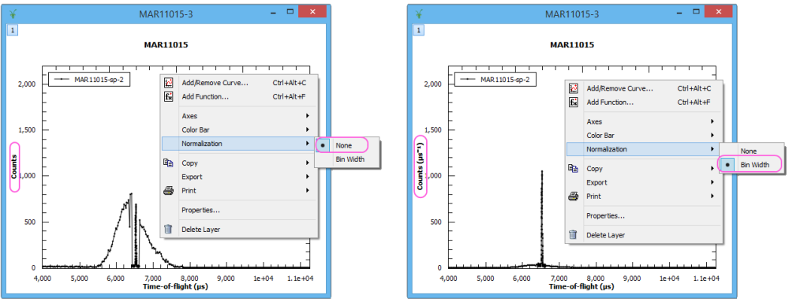
Histogram Plots
Histogram plots are now normalised to bin width by default
Data is not altered

Slide 26
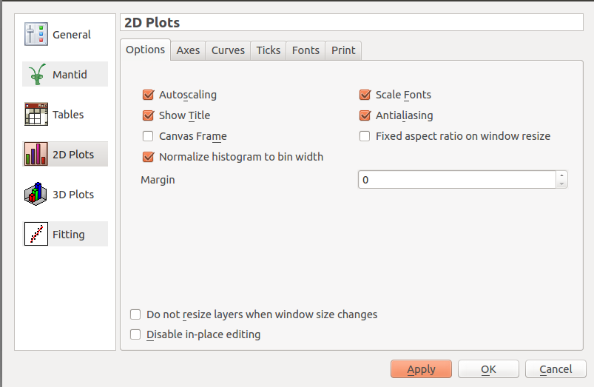
Histogram Plots
Histogram plots are now normalised to bin width by default

Slide 27
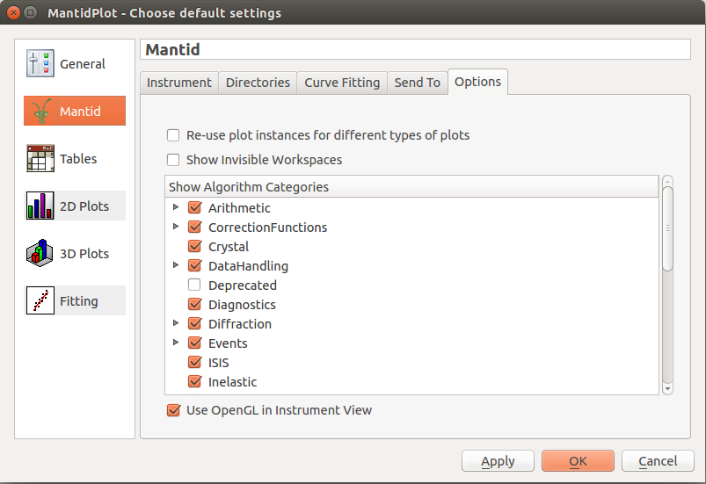
General Plot Options

Slide 28
Planned development starting ~12m
Planning tools
Resolution convolution
Multiple scattering sub project
Parallel algs
Parallel fitting (quantification)
Interface to 3rd party packages
Vates pub. quality plots
CLI improvements
Instrument control implementation

Slide 29
Planned development starting 12-24m
Remote Mantid project
Vates client/server
units

Slide 30
Planned training courses starting 12-24m
VATES
Py-QT
Technique specific i.e. SANS interface
Investigate links to external neutron training schools
In use at ISIS neutron training course

Slide 31
Science specific areas

Slide 32
SANS
Corrections
delQ 6m
Absorption 12m
Model fitting 12m
Others (12-24)

Slide 33
Reflectometry
Unify UIs
SNS complex 12m
ISIS simple 6m
Integrate SNS magnetism into Mantid 12m
Offspec tools sub project 24m

Slide 34
Diffraction
Fix rectangular detector issues 6m
Visible Time-slicing
Easy GUI 12m
Fast logs 12m
Single xtal UX 6m
crystal plan 12m
Unify Instrument calibration 24m

Slide 35
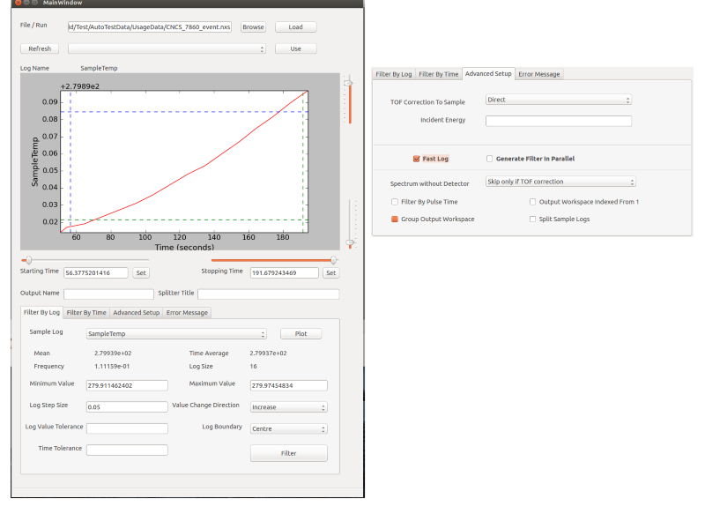
Visual time slicing

Slide 36
Event Filtering with Fast Logs
Fast logging required much higher precision around the filtering
When the sample environment state switches rapidly, the TOF of the neutrons must be taken into account, not just the pulse times for filtering purposes
Generation of the filters has been separated from the application of the filters in algorithmic terms
Used for Reflectometry and Elastic Diffraction at ISIS in limited capacity
Diagnostic Algorithms
RebinByTimeAtSample
RebinByPulseTime

Slide 37
INS
Mslice interface 6m
Planning tools 12m
Compare model to data 12m
Vates improvements to UX 6m
Include different resolution models 6m
TAS 24m

Slide 38
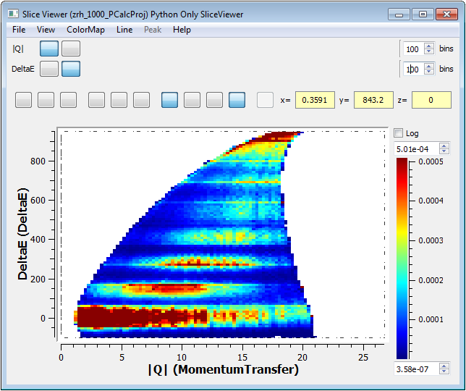
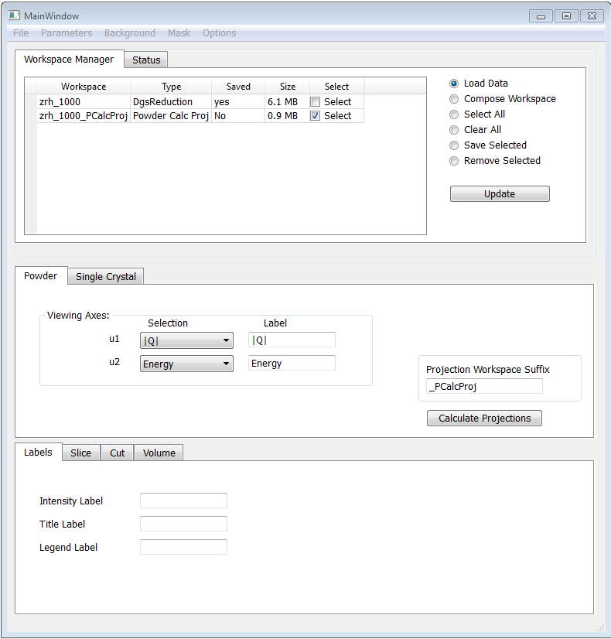
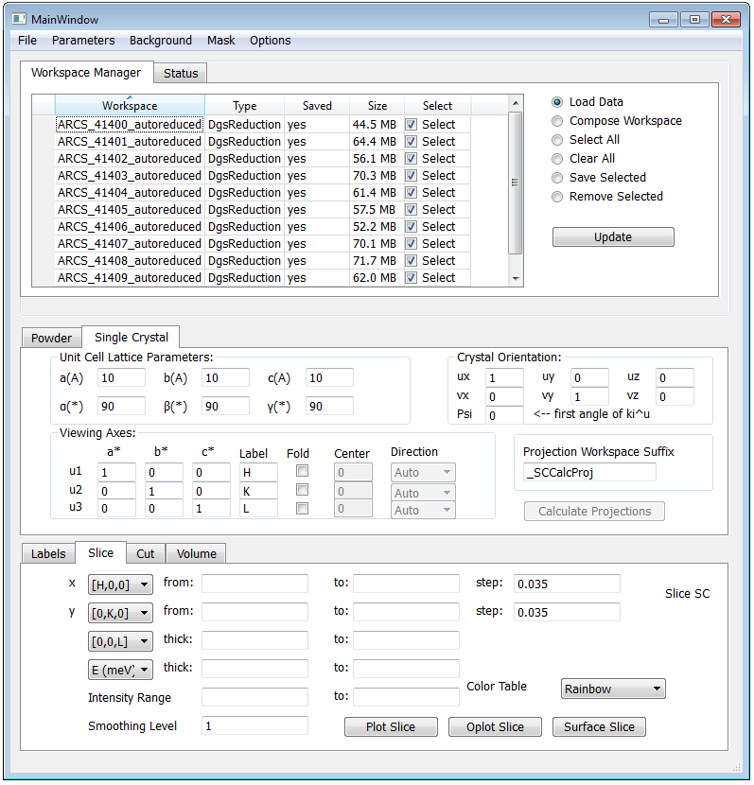
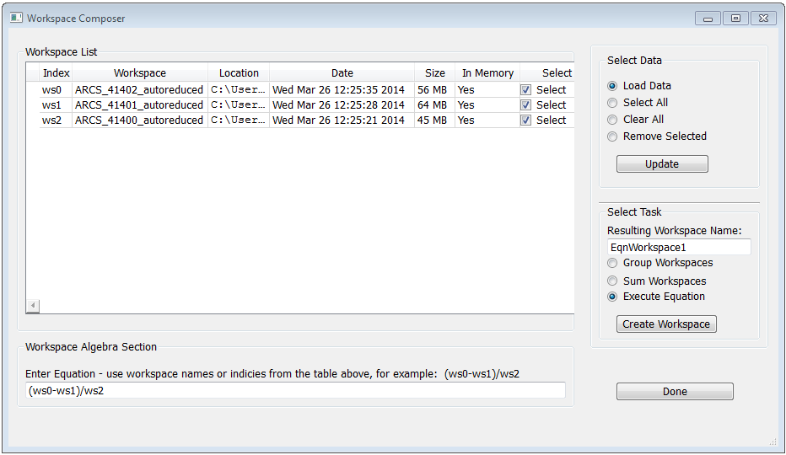
mSlice for Mantid

Slide 39
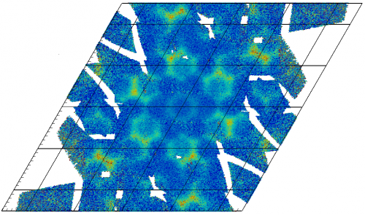
Normalisation
New Normalisation framework
Correctly accounts for statistical weights
MDNormSCD for elastic SC diffraction
Performance enhancements

Slide 40
Unexpected
Imaging and IMAT
Live Data
Adara packet changes
ISIS Live Data rate
Fixed problems with streaming ISIS event data
Now handles multi-period data
Paraview version changes
MD workspace create rate issues
The rise of Autoreduction

Slide 41
Outstanding Requirements
Improving support for instruments
Engin-X, GEM, Larmor, Vesuvio, Muons, reflectometry
Autoreduction
expand use at ISIS
ICAT
uploading data
implementation for SNS
cross facility queries
Live data
include log data (ISIS)

Slide 42
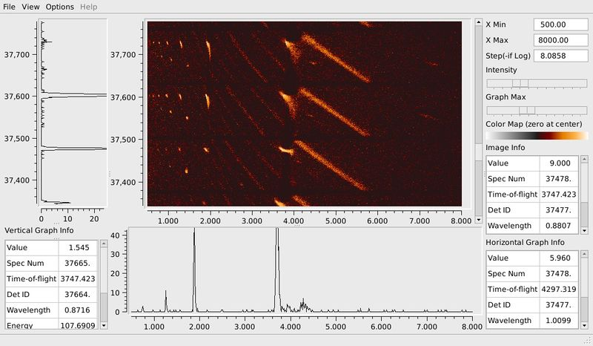
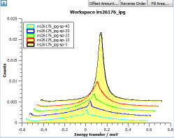
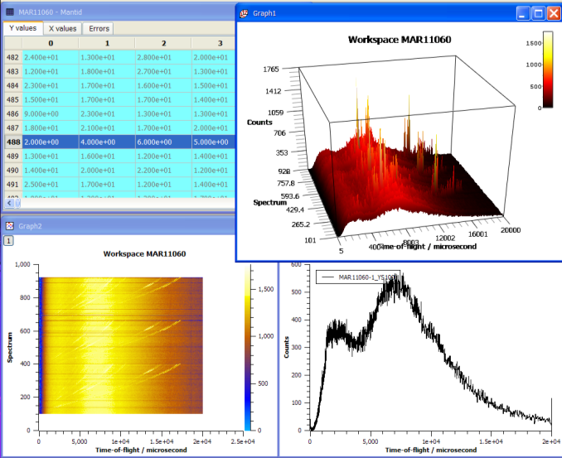
Our Graphs

Slide 43
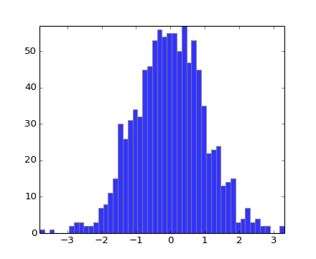
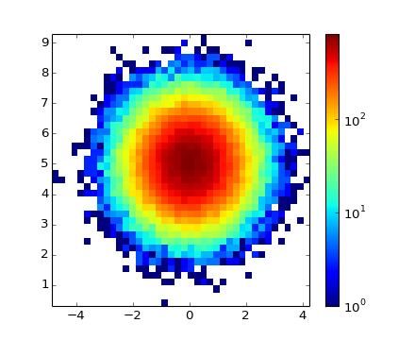
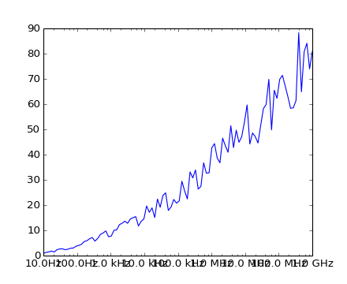
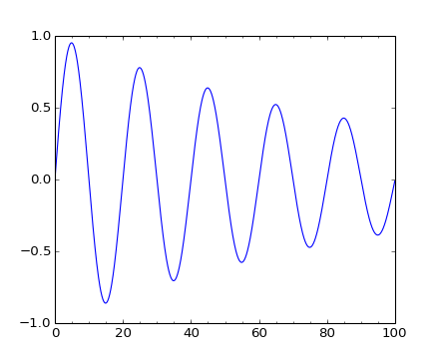
MatplotLib Graphs

